Slide 1
PRODUCT REVIEW ANALYSIS
(FLIPKART&AMAZON)

Slide 2
PROBLEM STATEMENT
1) Categorize & analyse the reviews to calculate the percentage of positive & negative reviews.
2) Calculate the total rating on a scale of 5 for each category.
3)Create a Ranking table for each Mobile phone based on each category and overall ranking.

Slide 3
TOOLS USED
Python
Pandas
Matplotlib,Plotly-dash
Sklearn
nltk
Wordcloud
Kaleido

Slide 4
APPROACHES
Import required tools
Cleansing
EDA
Removing unwanted column
Vectorization
Modelling

Slide 5
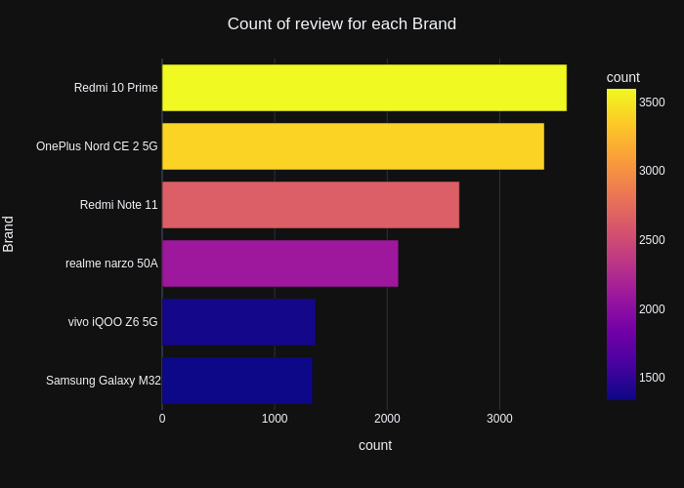
.

Slide 6
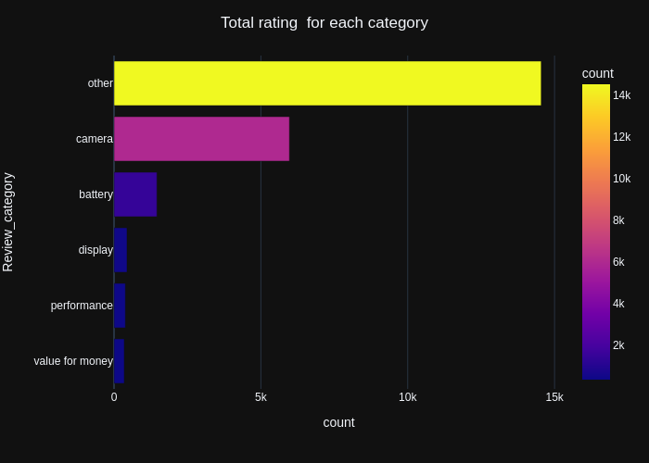
.

Slide 7
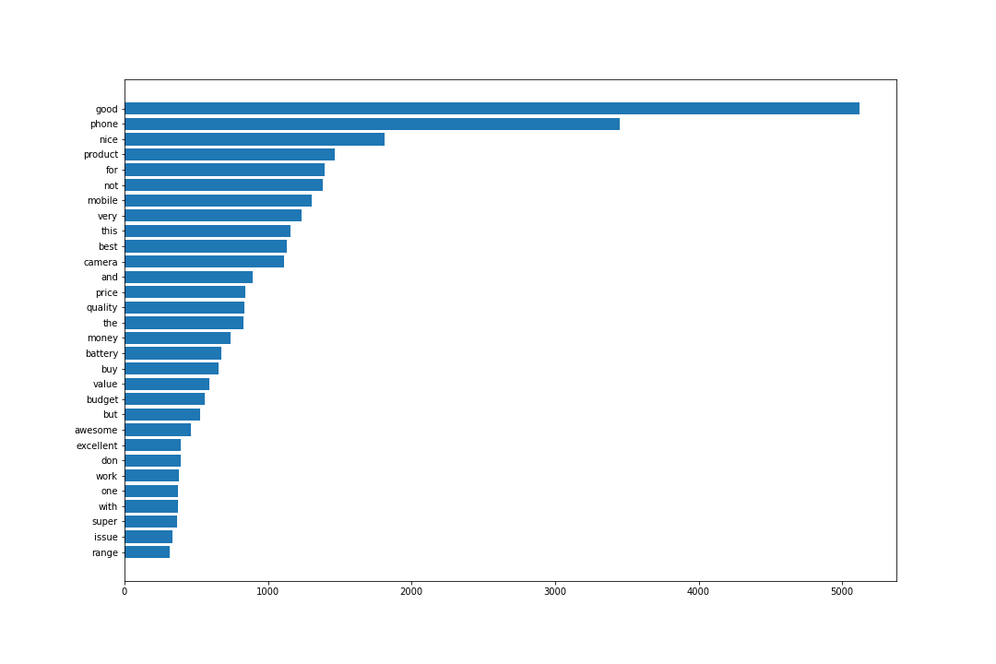
Most frequent positive words

Slide 8
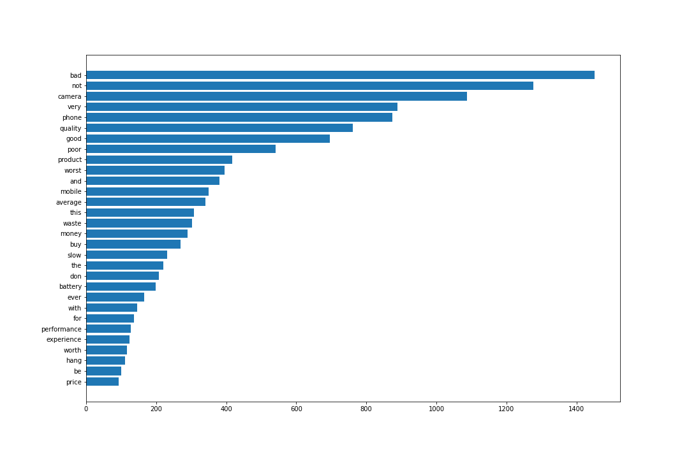
Most frequent negative words

Slide 9
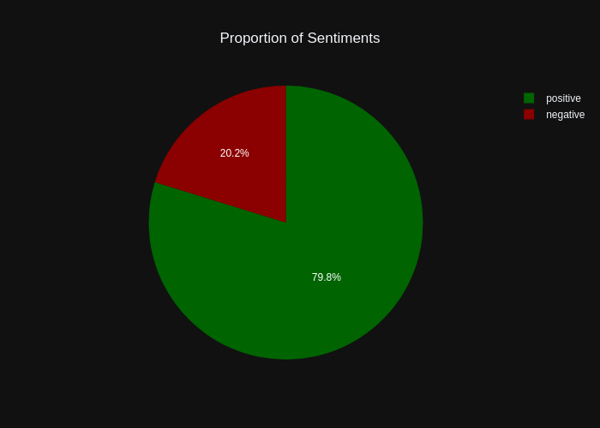
.

Slide 10

Positive Word Cloud

Slide 11
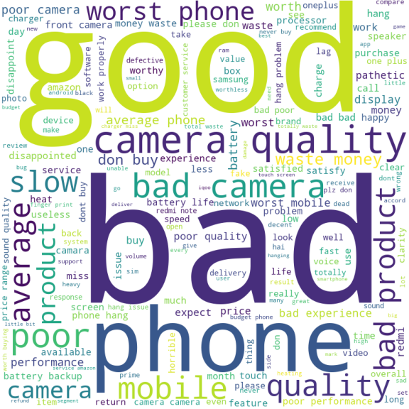
Negative Word Cloud

Slide 12
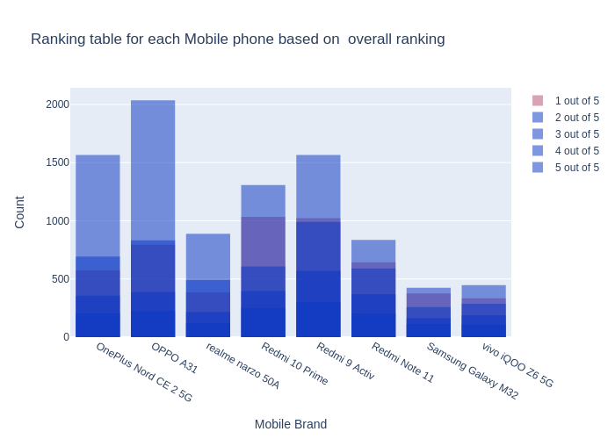
.

Slide 13
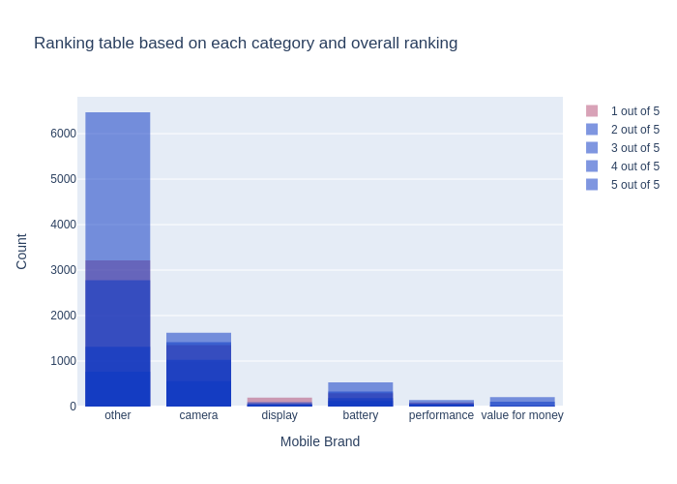
.

Slide 14
BEST ML MODEL
From my project the Gradient Boost Classifier gives me the high accuracy score.
Accuracy Score=0.8119602763385146
We can get more accurate predictions using Gradient Boosting Classifier.

Slide 15
EVALUATION MATRICS
This is a classification problem.So we can use accuracy,precision,recall as evaluation matrics.
Here I used Accuracy Score as a evaluation matric.

Slide 16
THANK YOU!

